Slide 1

ACO 2024 Quality Reporting Readiness
Web Interface Quality Reporting
January 2nd, 2025 to March 31st, 2025
We are transforming healthcare with smart solutions for providers, patients, caregivers, and payors, that creates integrated experiences resulting in enhanced overall health outcomes.

Slide 2


Housekeeping
Today’s Speaker
Submit your questions or chat via Q&A box
Slides will be available after today’s webinar
Our Newsletter "VBC News"
Gretchen Arciniega Program Director of Quality Health Endeavors

Slide 3


ACO 2024 Quality Reporting Readiness
ACO and Quality Reporting
Quality Reporting Timeline
CMS Web Interface Quality Measures
Quality Reporting Patients Sample
Health Endeavors Access
CMS WI Random Sample 2024 Tool
Quality Performance Score
Mass import EHR data
Security Official Reporting Decisions
Agenda
Notes:
Add or remove agenda topics as applicable for the client -

Slide 4
Consulting
QUALITY
QPP changes
APP Plus Quality Measure
MSSP and CMMI Models
SME Support
MSSP PI
Financial, Quality, Pop Health
Point of Care
Analytics
CareBotic
Benchmark Adjustment
Provider Analyzer
New codes
Maintain 5,000 Beneficiaries

Slide 5


ACO and Quality Reporting
ACOs must report quality data to CMS after the close of every performance year to be eligible to share in any earned shared savings and to avoid sharing losses at the maximum level.
For 2024 performance year, ACOs can report via the CMS Web Interface that requires them to submit data on a sample of Medicare patients for each quality measure or eCQM, MIPS CQM or Medicare CQMs.
Your ACO has contracted with Health Endeavors to collect quality data and send to CMS.

Slide 6
2024 Quality Reporting for ACOs
CMS Web Interface Random Sample
(Last Year)
10 CMS Web Interface quality measures
Random Sample (Medicare only)
MIPS eCQM/CQM
3 eCQM or MIPS CQM quality measures
75% data completeness of 100% of all eligible patients (Medicare and non-Medicare)
1 CAHPS for MIPS Survey
2 Claims-based measures
1 CAHPS for MIPS Survey
2 Claims-based measures
Medicare CQM
3 CQM quality measures
1 CAHPS for MIPS Survey
2 Claims-based measures
75% data completeness of 100% of all eligible Medicare FFS Patients

Slide 7
What is the time period to report quality data?
Description | Time Period
Patient ranking files to be available for download from CMS Web Interface. | Estimated: Around December 20, 2024
Patient list populated in Health Endeavors CMS WI Random Sample 2024 interface. | 2 to 4 days upon receiving the sample
ACO 2024 quality reporting period. | January 2nd, 2025 – March 31st, 2025
Last date to safely manually key 2024 quality data. | March 24th, 2025

Slide 8
2024 CMS Web Interface Quality Measures
10 measures required to actively report.
Quality measures set same as in 2023 performance year.
There are significant annual changes to the 2024 measure specifications.
The coding documents were updated with annual coding changes.

Slide 9
10 CMS Web Interface Quality Measures
ACO-13 (CARE-2) Falls: Screening for Future Fall Risk
ACO-27 (DM-2) Diabetes: Hemoglobin A1c Poor Control
ACO-28 (HTN-2) Controlling High Blood Pressure
ACO-40 (MH–1) Depression Remission at 12 Months
ACO-20 (PREV-5) Breast Cancer Screening
ACO-19 (PREV-6) Colorectal Cancer Screening
ACO-14 (PREV-7) Influenza Immunization
ACO-17 (PREV-10) Tobacco Use: Screening and Cessation Intervention
ACO-18 (PREV-12) Screening for Depression and Follow-up Plan
ACO- 42 (PREV-13) Statin Therapy for the Prevention and Treatment of Cardiovascular Disease.

Slide 10
2024 CMS Web Interface Quality Measures Changes
CARE-2 Falls: Screening for Future Fall Risk
No measure spec changes other than value set/coding updates.
(DM-2) Diabetes: Hemoglobin A1c Poor Control
Denominator Exclusion(s):
For 2024 Dementia combination Donepezil-memantine is added to the dementia medication exclusion list.

Slide 11
2024 CMS Web Interface Quality Measures Changes
(HTN-2) Controlling High Blood Pressure
Denominator Exclusion(s):
For 2024 Dementia combination Donepezil-memantine is added to the dementia medication exclusion list.
ACO-40 (MH–1) Depression Remission at 12 Months
Removed denominator exclusion:
Patients who were permanent nursing home residents any time during denominator identification period or the measure assessment period.

Slide 12
2024 CMS Web Interface Quality Measures Changes
ACO-20 (PREV-5) Breast Cancer Screening
Initial population: Updated to women 40-74 years of age who had a mammogram to screen for breast cancer in the 27 months prior to the end of the measurement period. In previous years, the measure was applicable to patients 50-74 years of age.
​
Denominator Exclusion(s):
For 2024 Dementia combination Donepezil-memantine is added to the dementia medication exclusion list.

Slide 13
2024 CMS Web Interface Quality Measures Changes
ACO-19 (PREV-6) Colorectal Cancer Screening
Denominator Exclusion(s):
For 2024 Dementia combination Donepezil-memantine is added to the dementia medication exclusion list.
​
Numerator Description update:
Fecal immunochemical DNA test (FIT-DNA) during the measurement period or the two years prior to the measurement period has been updated to read: Stool DNA (sDNA) with FIT test during the measurement period or the two years prior to the measurement period

Slide 14
2024 CMS Web Interface Quality Measures Changes
ACO-14 (PREV-7) Influenza Immunization
Denominator Exclusion(s):
For 2024 Anaphylaxis due to the vaccine during or before the measurement period has been added.
This measure has been updated to allow reporting receipt of influenza immunization for the two flu seasons (Flu Season 2023- 2024 and Flu Season 2024-2025) that fall within the performance reporting period.
For the purposes of the program, in order to submit on the flu season 2023-2024, the patient must have a qualifying encounter between January 1 and March 31, 2024. In order to submit on the flu season 2024-2025, the patient must have a qualifying encounter between October 1 and December 31, 2024.

Slide 15
2024 CMS Web Interface Quality Measures Changes
ACO-17 (PREV-10) Tobacco Use: Screening and Cessation Intervention
Updated initial population: Percentage of patients aged 12 years and older who were screened for tobacco use one or more times within the measurement period AND who received tobacco cessation intervention during the measurement period or in the six months prior to the measurement period if identified as a tobacco user.
​
Previously this measure looked at patients aged 18 years and older.

Slide 16
2024 CMS Web Interface Quality Measures Changes
ACO-18 (PREV-12) Screening for Depression and Follow-up Plan
Updated exclusions: Removed diagnosis of depression from the exclusions

Slide 17
2024 CMS Web Interface Quality Measures Changes
ACO- 42 (PREV-13) Statin Therapy for the Prevention and Treatment of Cardiovascular Disease.
Risk Category changes:
​
Risk Category 2 has been updated to "Patients aged 20 to 75 years at the beginning of the measurement period who have ever had laboratory result of LDL-C >190 mg/dl or were previously diagnosed with or currently have an active diagnosis of familial hypercholesterolemia" Previously this was patients >20 years of age.
​
Risk Category 4 has been added "Patients aged 40 to 75 years at the beginning of the measurement period with a 10-year ASCVD risk score of >20 percent during the measurement period."

Slide 18
Sample Size and Ranks
Random Sample Rank file expected to be received around December 21, 2024.
Patients ranked 1 to 616 in each Module (except for PREV-13, Statin Therapy , that will have a sample of 750 beneficiaries).
  May have less than 616 if not enough patients to fill the module.
ACO required to complete 1 to 248 consecutively. For each patient that is skipped, the organization must completely report on the next consecutively ranked patient until the target sample of 248 is reached or until the sample has been exhausted.
249 to 616 the oversample (Patient or Module Skips).

Slide 19
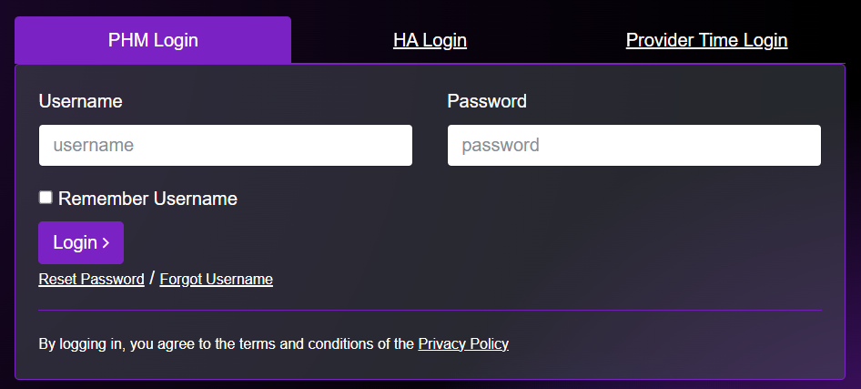
How do I report ACO Quality Measures?

Slide 20
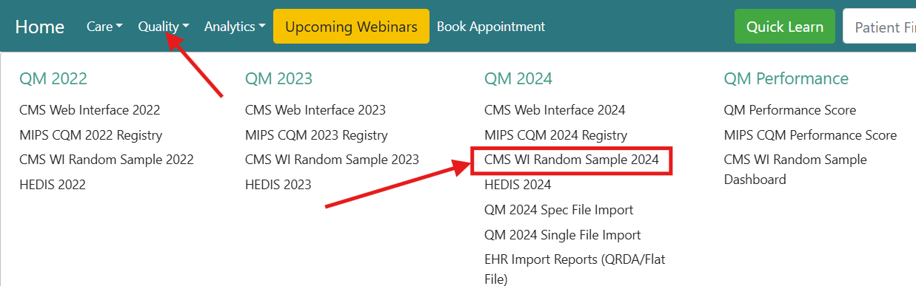

Access CMS WI Random Sample 2024 – Health Endeavors

Slide 21
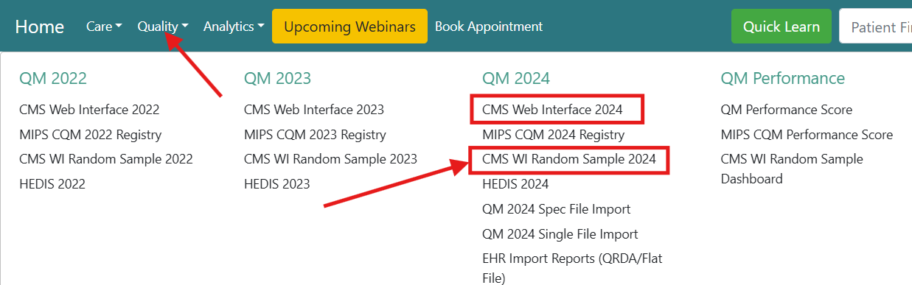
Difference between CMS WI Random Sample 2024 and CMS Web Interface 2024

Slide 22
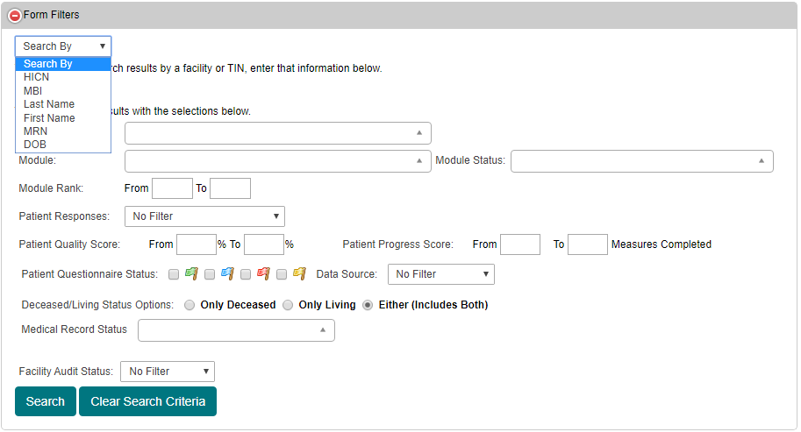
CMS WI Random Sample 2024 Filters

Slide 23
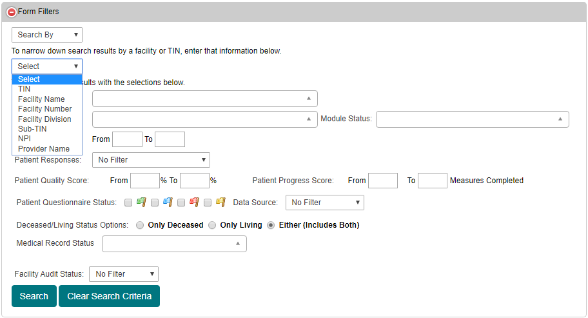
CMS WI Random Sample 2024 Filters

Slide 24
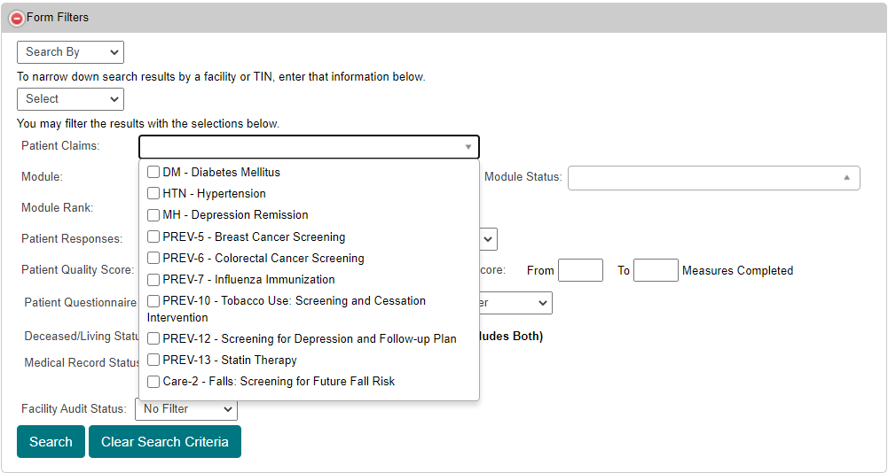
CMS WI Random Sample 2024 Filters

Slide 25
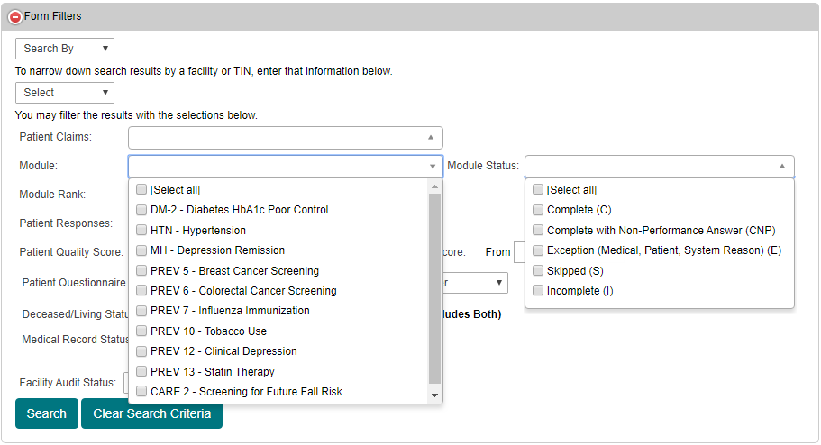
CMS WI Random Sample 2024 Filters

Slide 26
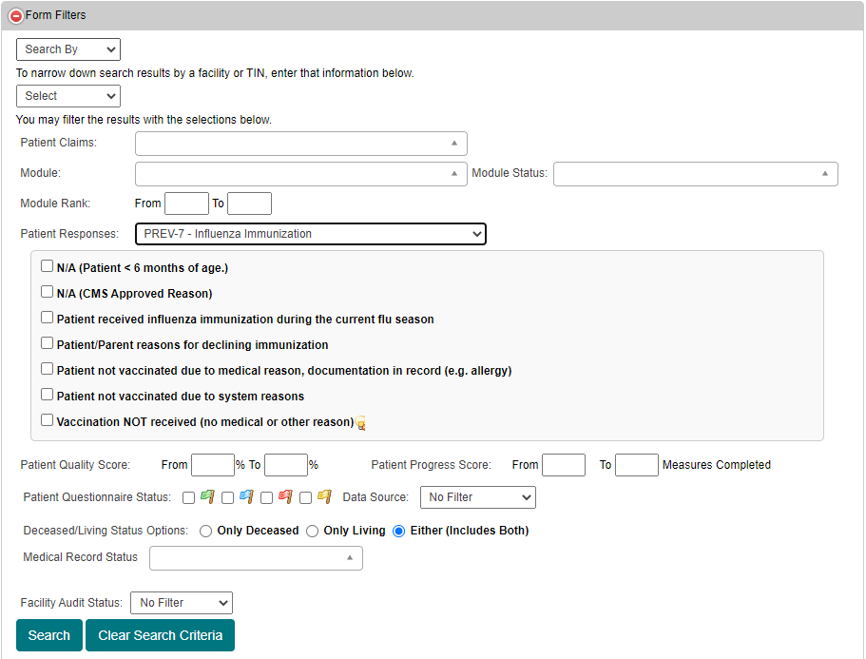
CMS WI Random Sample 2024 Filters

Slide 27
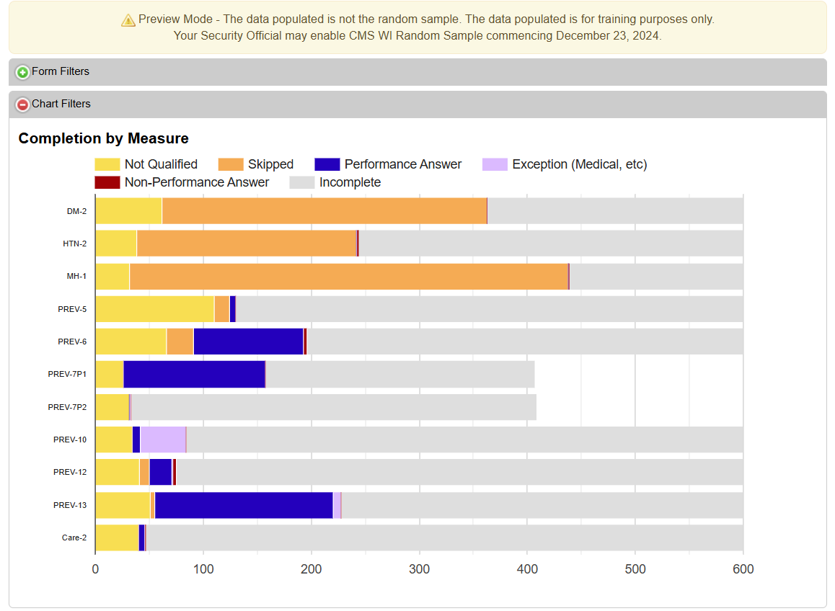
How do I use the Health Endeavors CMS WI Random Sample 2024 Tool?

Slide 28
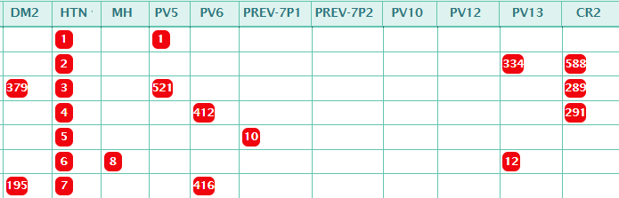
Sort Ranks for a Measure Lowest to Highest
Example: Hypertension

Slide 29
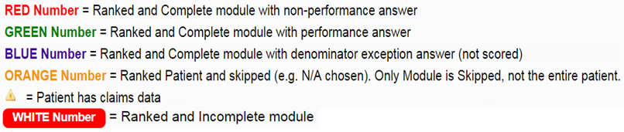
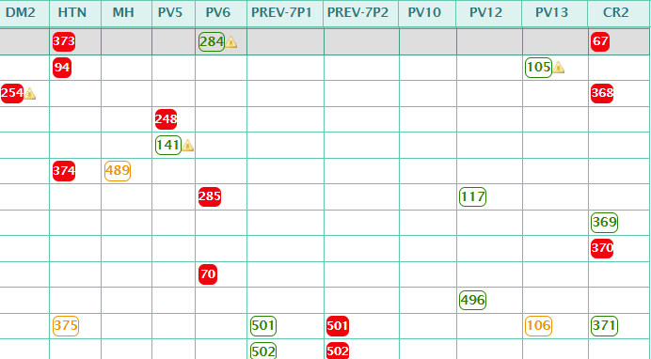

Slide 30
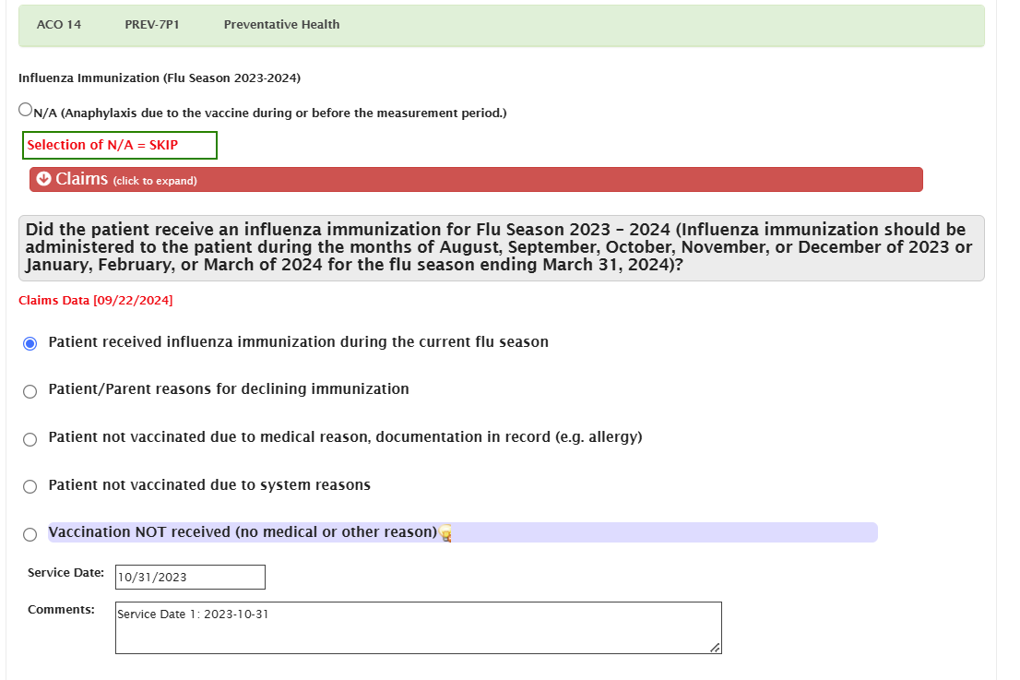
Mandatory Patient Defaults & Data Imports
“N/A” if outside age range, gender.
Carryover prior year responses; e.g. Breast Cancer Screening.
Deceased and Hospice mark patient as N/A.
EHR and Claims data has been imported – See label.

Slide 31
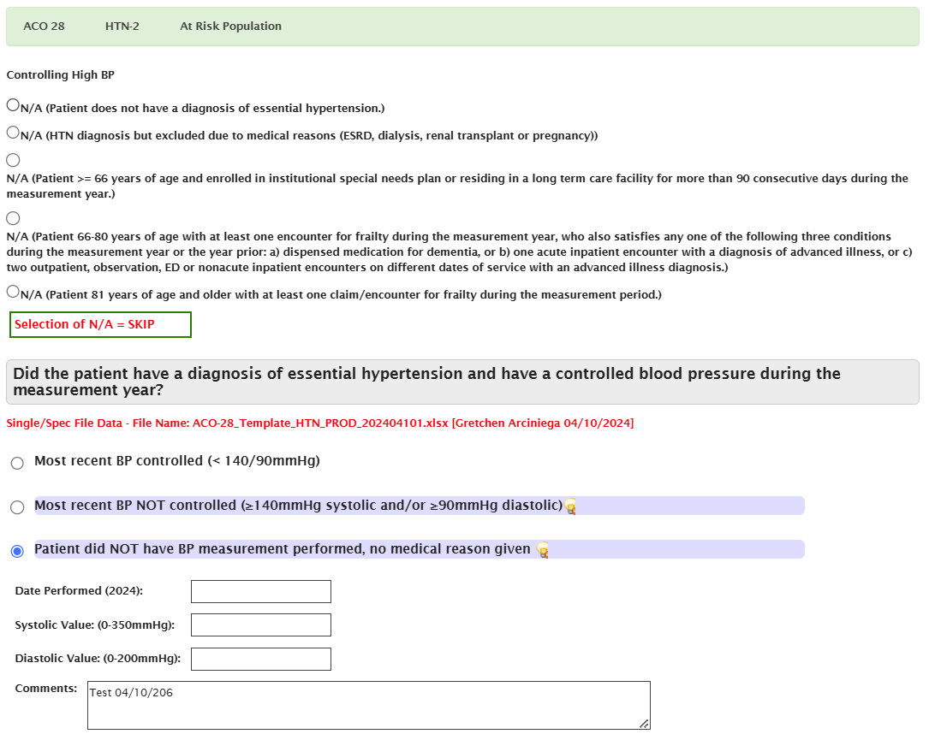
Click on Grid

Slide 32
Data Source

Slide 33
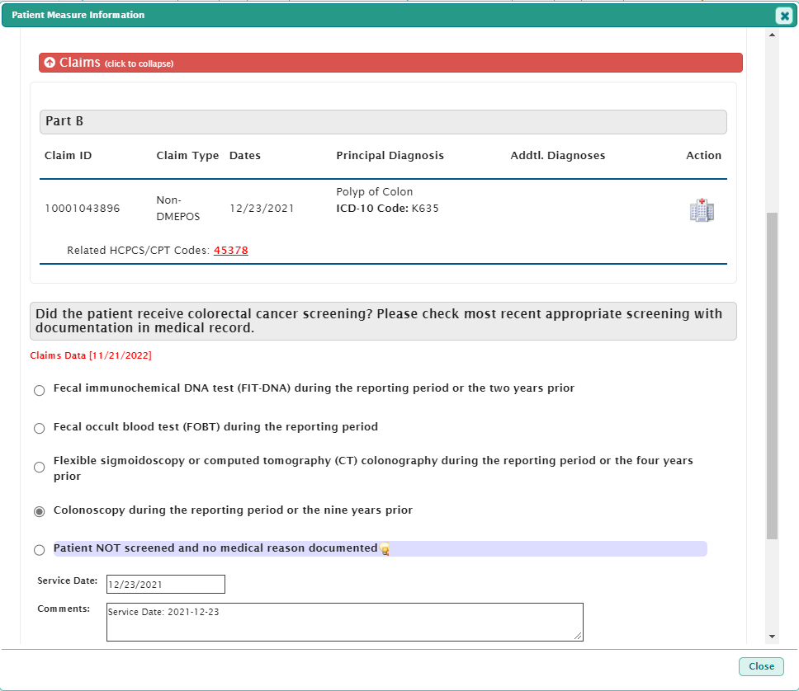
Claims Data Expansion

Slide 34

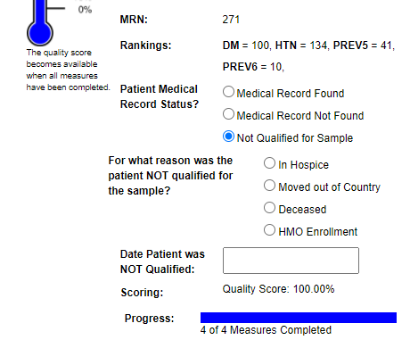
Medical Record Status

Slide 35
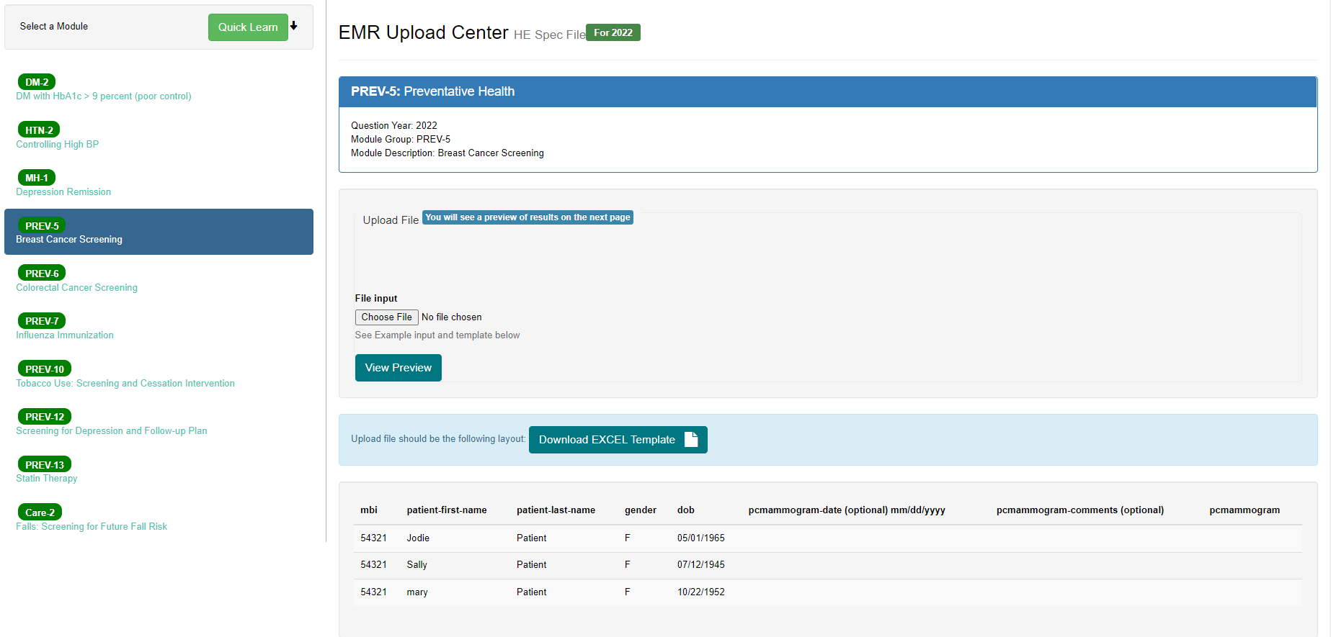
How to mass import EHR data directly into the tool?
Setup a 1-1 meeting with Health Endeavors to be trained on the process.

Slide 36
Spec File Import Tool

Slide 37
Spec File Import Tool
All questionnaire responses can be imported using the tool.
Select the module from the sidebar.
Upload the properly formatted file that contains the patient MBI or Patient First Name, Last Name and DOB.
Each measure contains a template to be used for the data.
An answer legend will be provided for each measure to detail the responses.
You will be provided a preview of actions to be taken prior to any updates being committed.
The process is limited to 1000 records per upload.

Slide 38
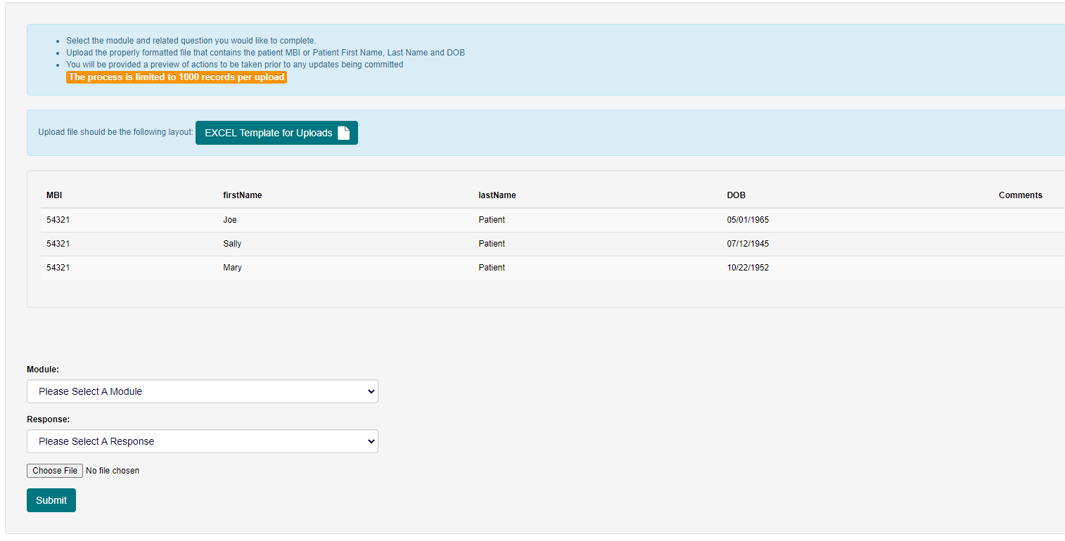
Single File Import Tool

Slide 39
Single File Import Tool
Only positive questionnaire responses can be uploaded with the tool.
Select the module and related question you would like to complete.
Upload the properly formatted file that contains the patient MBI or Patient First Name, Last Name and DOB.
You will be provided a preview of actions to be taken prior to any updates being committed.
The process is limited to 1000 records per upload.

Slide 40
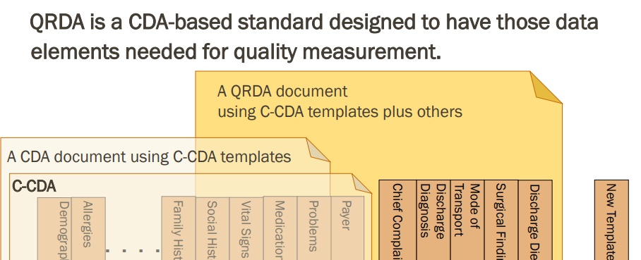
QRDA Category I Files
QRDA is a Clinical Document Architecture (CDA)-based standard for reporting patient quality data for one or more quality measures
  QRDA Category I (Single Patient Report) Individual patient-level report that contains data defined in the measure.
  QRDA Category III (Calculated Report) Aggregate quality report with a result for a given population and period of time.
Health Endeavors only accepts QRDA Category I files.

Slide 41
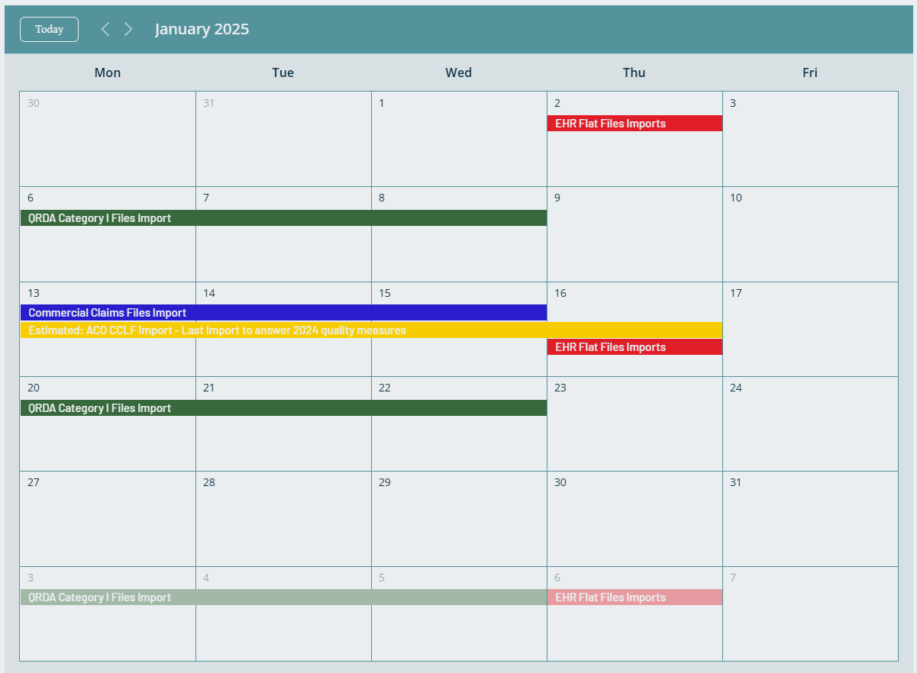
Health Endeavors File Processing Calendar
https://www.pophealthproject.com/pop-health-projects

Slide 42
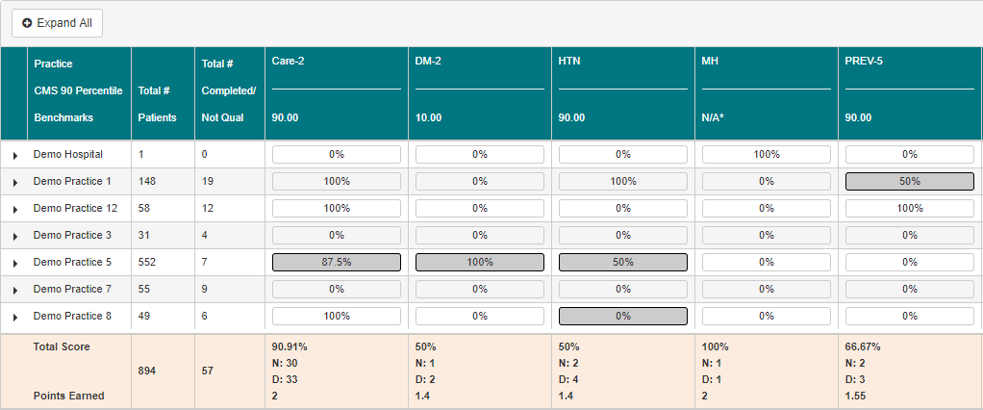
What is my practice or NPI quality score?
Quality Measures Scoring Tool calculates scores at the practice/provider level.

Slide 43
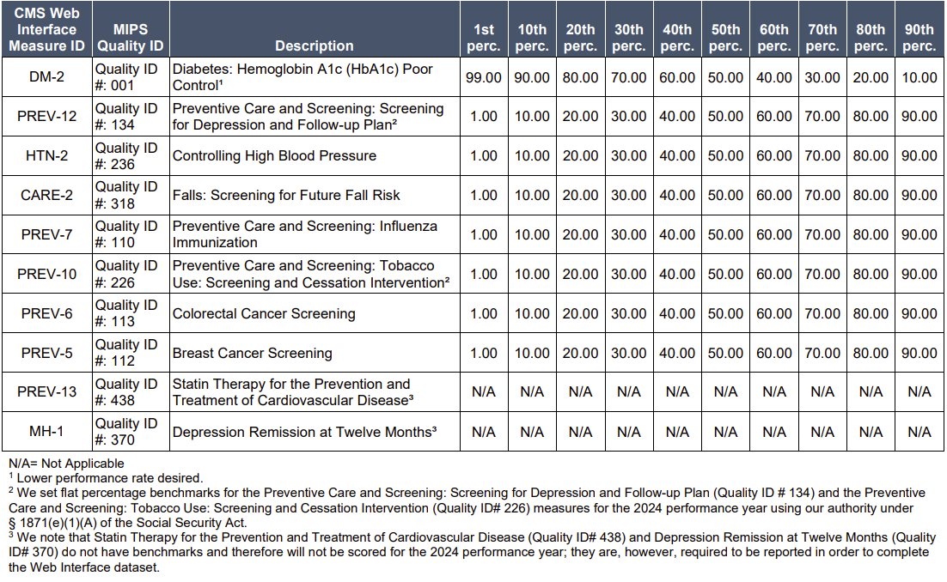
CMS Web Interface Benchmarks

Slide 44
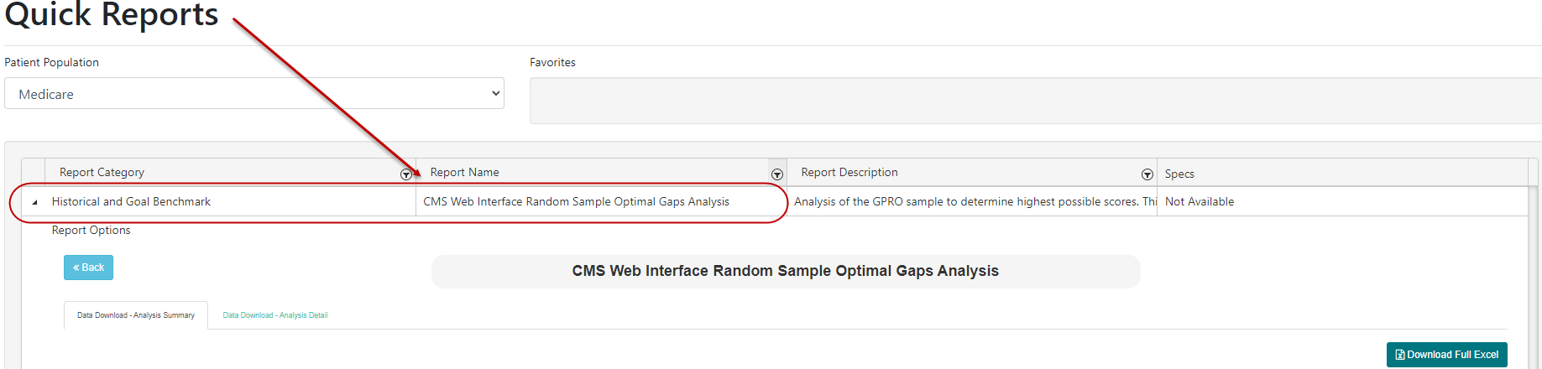
CMS WI Random Sample Optimal Gaps Analysis Report

Slide 45
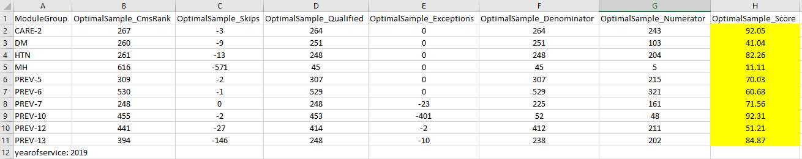
CMS WI Random Sample Optimal Gaps Analysis Report
Optimal Gaps Analysis calculates the best possible quality score you can achieve.

Slide 46
Tips & Pitfalls
Have a Plan of Action for excessive measure Skips; e.g. not able to confirm diabetes.
Do not get stuck on 1 record. In the first 14 days complete as many records as possible.
You can always return to a record.
Do not spend a lot of time on requested dates in the questions if not legible as CMS allows you to default to December 31, 2024.
Do not overwrite data unless you are certain the data is correct and more recent than the data entered.
Be done in 8 weeks (NOT 12 weeks)

Slide 47
Reminder - Reporting Timeline
Description | Time Period
Patient ranking files to be available for download from CMS Web Interface. | Estimated: Around December 20,2024
Patient list populated in Health Endeavors CMS WI Random Sample 2024 interface. | 2 to 4 days upon receiving the sample.
The CMS Web Interface opens for quality reporting (data entry and submission). | January 2nd, 2025

Slide 48
Reminder - Reporting Timeline
Description | Time Period
Health Endeavors uploads data via API to CMS Web Interface on weekday daily basis. | January 6th, 2025
Health Endeavors to stop taking 2022 EHR Imports (automation and Submit a Request files). | February 20th, 2025
Health Endeavors stop processing CCLFs for patients included in CMS WI Random Sample. | CMS WI Random Sample 2024 patients won’t be updated with answers from claims data after the January CCLFs import.
Health Endeavors’ Single and Spec File Mass Imports. | Last date to submit is March 24th, 2025
Health Endeavors Manual Key. | Last date to submit is March 24th, 2025
The CMS Web Interface closes for 2024 quality reporting (data entry and submission). | March 31st, 2025

Slide 49

ACO Security Official CMS WI Random Sample Decisions
ACO administrative user (Security Official) must configure priorities for measure data sources, preferences for CMS WI Random Sample 2024 portal and final quality measures data submission to CMS.

Slide 50
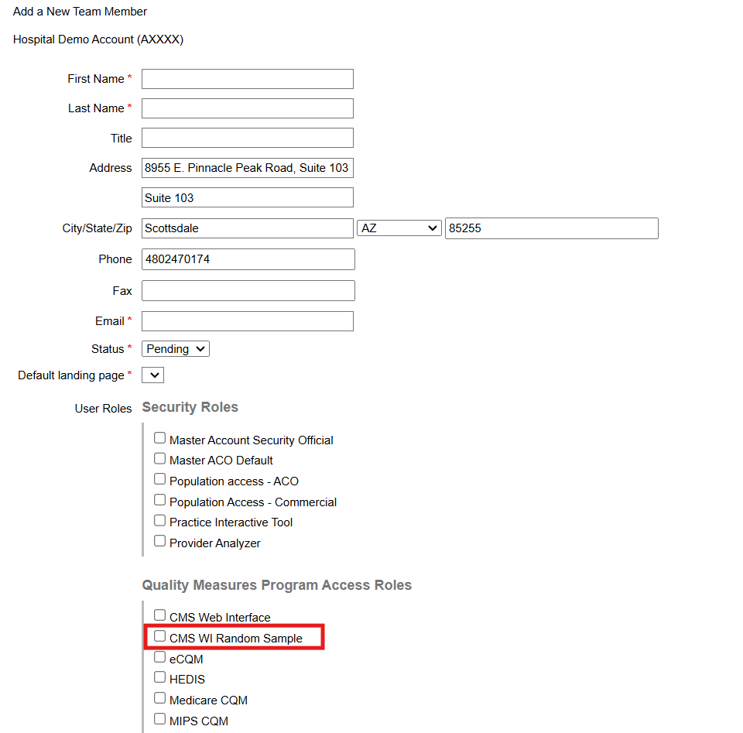
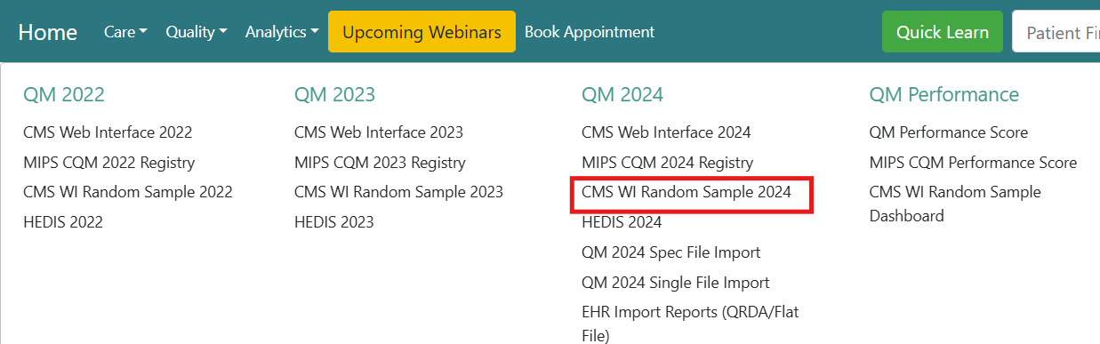
Access CMS WI Random Sample 2024 – Health Endeavors

Slide 51
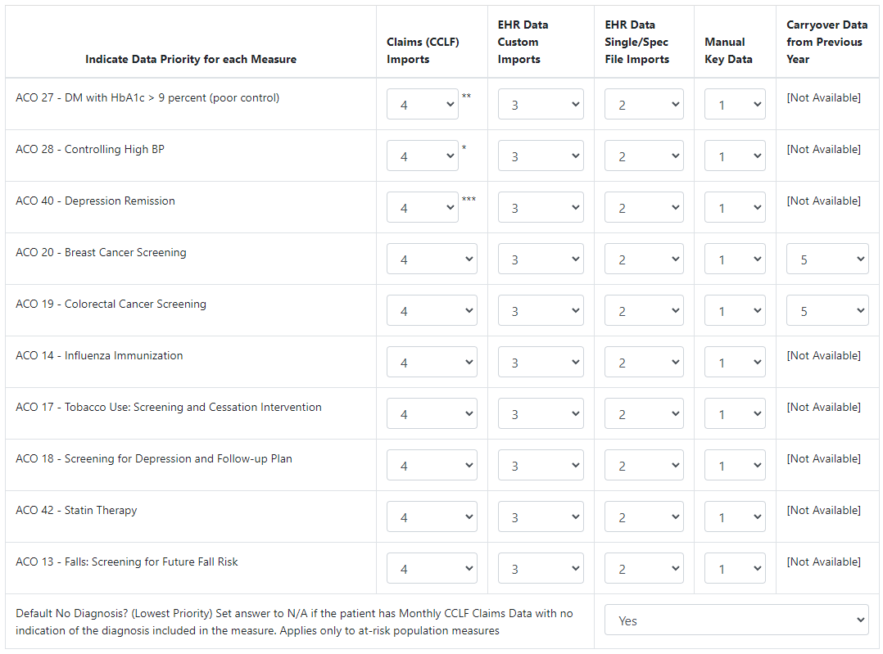
QM Import Chart
Configure priority levels for data sources on individual quality measures.

Slide 52
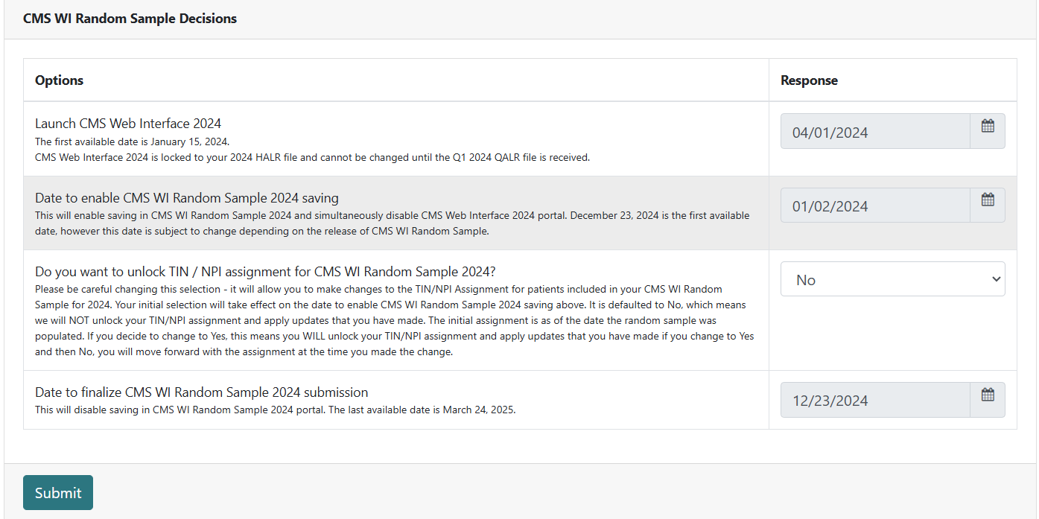
CMS WI Random Sample 2024 Decisions

Slide 53
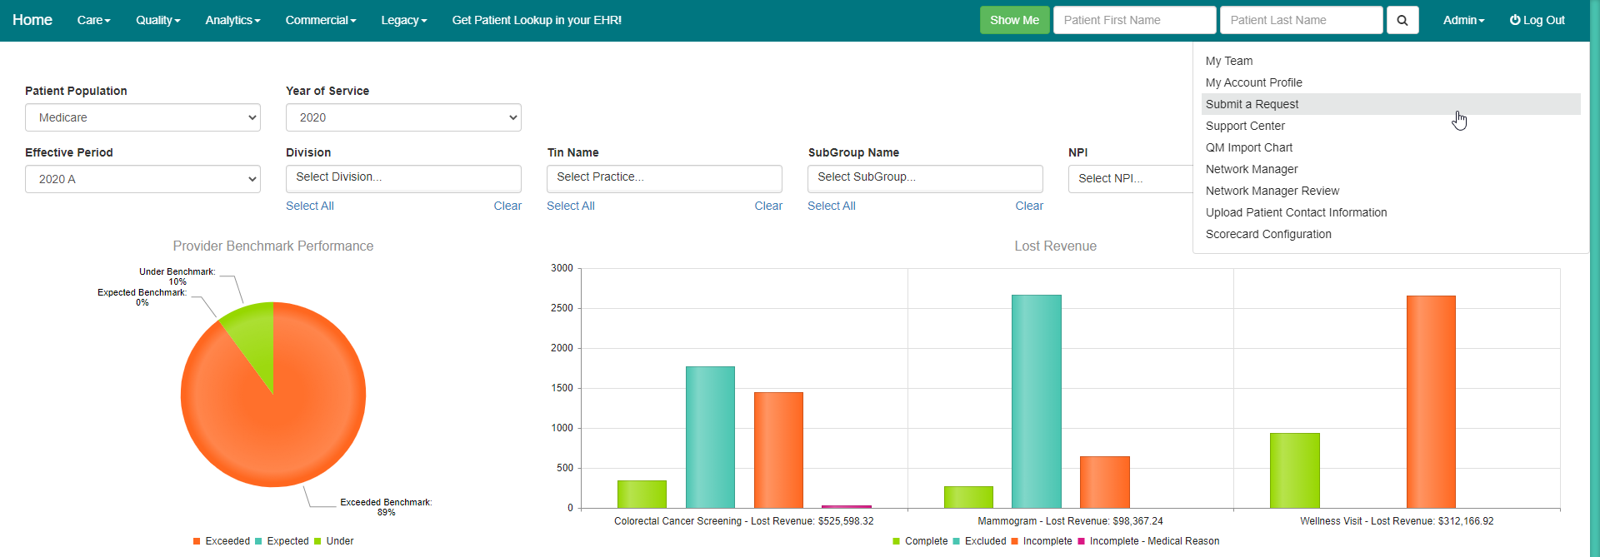
Submit a Request or 1-888-862-0366

Slide 54
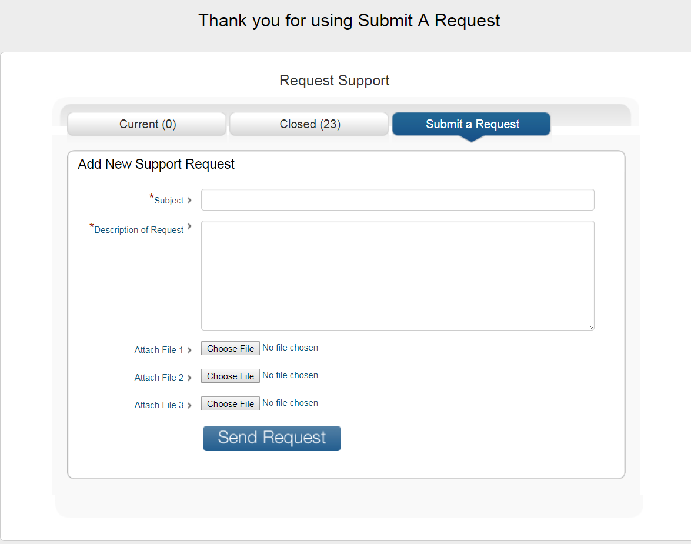

Slide 55
Book your 1:1 Training
Program Director of Quality
Gretchen Arciniega
gretchena@healthendeavors.com
We are transforming healthcare with smart solutions for providers, patients, caregivers, and payors, that creates integrated experiences resulting in enhanced overall health outcomes.

